Slide 1
Home Energy Infrastructure
Interoperability & Integration
2025-04-05
V0.2.0
Don Jackson

Slide 2
Home Energy Infrastructure (HEI) Devices
The devices that provide and support the electrical system of a home:
Utility Meter: provided (and owned) by the Load-Serving-Entity (LSE)
Microgrid Interconnect Device (MID) and/or Transfer-Switch
Electrical panels: conventional and/or “smart”
Battery backup systems (BESS)
PV systems
Meters: within the home
V2X-EVSE
V2X enables the EVSE+EV to be a grid-forming-DER
Non-V2X-EVSE is “only” a high-load appliance (not that there's anything wrong with that!)
Generators: permanent or portable
HEI Device Attributes
Subject to, and compliant with, the National Electric Code, listed to UL standards
AHJ and AGIR approval required before installation, and inspections required afterwards
Installed by licensed professionals (not homeowner)
Reliability and dependability are critical to the homeowner

Slide 3
HEI Landscape
Many homes utilize HEI devices from different manufacturers
BESS, PV, V2X-EVSE (more than one!), “Smart” Panels
HEI devices desire/require connection to the Internet and/or cloud
Typically, and least expensively, via connection to the home’s LAN
For connection to manufacturer’s cloud, FW updates, and to enable smartphone app for homeowner
HEI devices need to communicate and coordinate with other HEI devices
Grid-status, MID-status, SOE, remote-metering, load-shedding, power-attenuation, energy-shifting
Device Integration APIs
If provided at all, poorly documented, and typically unsupported
Some manufacturers provide only Cloud-based APIs, that:
Suffer from latency issues in the the best case
Unlikely to be available during grid outages, when needed most
Typically based on a RESTfull (request-response) interaction model

Slide 4
HEI Landscape - Continued
Microgrid Interconnect Device (MID)
The MID function is typically integrated into a single, specific, grid-forming-DER
The integrated MID is unable to interoperate with additional grid-forming DERs
Many HEI devices require metering data from circuits/devices elsewhere

Slide 5
Current HEI Interop/Integration Challenges
Each HEI device-device integration is a custom, unique, development effort, which requires the direct involvement of one (or both!) HEI device vendors
Every HEI device is metering what it has/can, but not sharing!
When Device-A needs to know what is happening at Device-B, Device-A must provide an unnecessary (and redundant) remote-meter, adding cost and complexity, i.e. Tesla+Neurio
Lack of HEI command & control APIs results in kludgey workarounds that cause other problems
Tesla Powerwall ESS needs to curtail PV when off-grid and SOE high (no way to use that excess PV power)
To do so, Powerwall moves the line frequency out-of-spec, causing PV shutdown, bad side effects:
Flickering of llight dimmers
Household UPS units interpret the line-frequency change as grid/power failure:
Transition to battery power, even though the ESS is still powering the home
The much lower capacity UPS battery drains within minutes, resulting in power loss to the home’s network/computing infrastructure!

Slide 6
More Current HEI Interop/Integration Challenges
Request-Response (REST) style APIs result in constant and frequent polling by each and every API client device
HEI devices are getting hammered by everyone else asking for the same information!
Creates a many-to-many problem, everyone is asking everyone else for everything

Slide 7
HEI Integration Challenges are Growing!
Flexible-Demand and Demand-Response
PUCs will require, and LSEs will want/need to, signal highly-dynamic pricing and demand-response requests, in order to shift energy and attenuate demand
HEI devices will want/need to communicate and control these flexible-demand appliances
Power Control and Avoiding Service Upgrades
NEC-705.13 & UL-3141 Power Control Systems (PCS/EMS) standards enable support of new, large loads within the home, without costly service upgrades, 100 Amp service is not a barrier to whole-home electrification!
PCS/EMS capabilities will also provide benefits to DERs and homeowner during grid outages
Homeowners will demand support for multiple grid-forming DERs
E.g. a BESS, PV-system, one or more V2H/V2G capable EVSEs/EVs, and a portable generator for emergencies
Therefore the MID MUST become a separate/distinct HEI device, and MUST be capable of communicating and coordinating with multiple DERs
A “market-leading BESS vendor” is currently shopping their 3P MID spec, “smart” panels may well include a MID
Homeowners will demand integration of disparate HEI devices into whole-home EMS and home-automation systems

Slide 8
HEI Device Integration Requirements
Connectivity/Communication
HEI devices need to get to the Internet/Cloud (“phone home”, user-app support)
HEI devices MUST be interconnected to communicate/cooperate
Support for multiple Devices/Clients
More than one subscriber may want/need status/state/measurement data
MID and multiple DERs will need to coordinate
Discovery
HEI devices need to be found (by each other) on the LAN
Protocols & APIs
Open, free-to-use, documented, and (ideally) standard
Support publish/subscribe FIRST, only when necessary & appropriate: REST/CRUD
All API access MUST be LOCAL, not via a cloud

Slide 9
HEI Device Integration Requirements - 2
Authentication, Authorization, and Security
Control of home’s power, energy, and loads must be secure.
Measurements and state have significant privacy implications.

Slide 10
HEI Interop Proposal
HEI device providers should adopt a common interop/integration framework, the working name for which is:
“Electrification Bus”
AKA
“eBus”

Slide 11
eBus Framework Principles
Connectivity: IP networking
Primarily hardwired Ethernet, secondarily, if necessary, Wi-Fi
Network Discovery: mDNS
Each HEI device should advertise its existence and capabilities via mDNS
Discover other HEI devices by listening for their advertisements/broadcasts
APIs:
“Publish/Subscribe First”, using the standard message protocol - MQTT
Each HEI device publishes its status and state to MQTT topics
Inter-device control via messages on command topics
REST APIs, for when CRUD is the “right tool for the job”
Enrollment/Authentication/Authorization:
Define process enabling guided (if not automated) workflows
Transport Security:
Aspirationally, mutual TLS would be used.

Slide 12
eBus Framework Principles - continued
API Discovery: HEI devices MUST publish their interface specs (locally)
Message broker topics: Homie, and possibly AsyncAPI
REST: OpenAPI
Message schemas: JSON Schema
Device Discovery Registry
Is a centralized database of HEI discoverable devices needed?

Slide 13
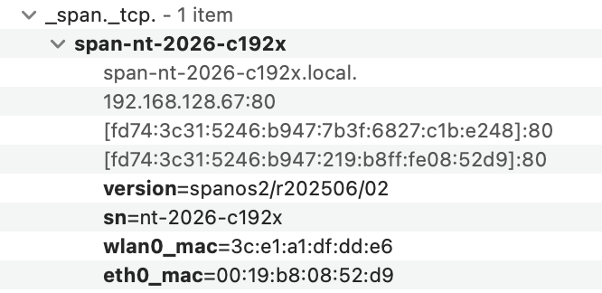
eBus Practicalities - Discovery
Discovery/mDNS
Advertising via mDNS is easy on even ESP32/ESPHome microcontrollers, and trivial on on Linux (using avahi), “just do it”
Receiving mDNS on Linux (using avahi) is straightforward
Example mDNS advertisement by a SPAN smart panel:

Slide 14
eBus Practicalities - Message Brokers
Message-Brokers/MQTT
Connecting to MQTT brokers and topic subscription & publishing is easy on both microcontrollers and Linux
Hosting a MQTT broker (e.g. Mosquitto) on Linux is straightforward
Some HEI devices will want/need to host their own broker
Other devices with brokers of their own can use MQTT-bridging functionality to seamlessly arrange for remote-broker topics & messages to be available on their local broker
HEI devices that don’t support a local MQTT broker can arrange to publish and subscribe to another device’s broker

Slide 15
eBus Practicalities -
MQTT Topic & Message Formats
eBus has adopted the Homie Convention (v5):
The Homie Convention is a communication definition on top of MQTT between IoT devices and controlling entities.
The Homie Convention defines a standardized way of how IoT devices and services announce themselves and their data on the communication channel.
The Homie Convention is thereby a crucial aspect in the support of automatic discovery, configuration and usage of devices and services over the MQTT protocol.
The eBus/Homie Convention provides:
A standard framework and structure for HEI device topics and their payloads
Requires each device to publish a schema defining its structure and properties
Property schema includes datatype, unit-of-measure, and support for clients to publish “commands” (via the settable attribute of a property)
A well-defined “life cycle” for devices, enabling clients to know the state and status of others
A well-defined extension mechanism

Slide 16
eBus Practicalities - Adapters & Proxies
What if “some HEI vendor” doesn’t support eBus? (a “pedestrian”)
Any eBus device (a “rider”!) could integrate with the pedestrian device “by any means necessary”, for example: poll that device’s REST API, or communicate via legacy Modbus/RS-485 interfaces, and publish/represent the pedestrian device to an eBus broker, using the eBus/Homie convention. Such an integration is an example of an eBus “adapter”
Other eBus rider devices can access the pedestrian’s data via MQTT, in effect, the rider that adapted the pedestrian device is proxying the pedestrian’s data to eBus.
Note that eBus adapters may be implemented by anyone, anywhere, on the home’s LAN! HEI device manufacturers won’t necessarily need to develop all eBus integrations themselves. And once one “rider” has adapted/proxied a pedestrian’s data, all eBus riders benefit!

Slide 17
eBus and Other Protocols, APIs, & Standards
eBus’ focus is HEI devices
Not IoT
Not Utility/Customer signaling
eBus (and its riders) embraces other standards that facilitate communication and interoperation with other energy system participants and devices
Examples:
eBus devices will want to communicate and control IoT devices (typically loads) in the home, via protocols like Matter, CTA-2045, and OpenADR-3. eBus adapters to these protocols provides visibility and control of devices supporting these protocols in the home to eBus riders
An eBus-OpenADR-3 adapter would connect to the LSE’s price-server, and provide prices and grid-events to eBus riders
An eBus device needing to control a flexible-demand load might use either Matter or OpenADR-3 to control the load’s power or shift its energy consumption

Slide 18
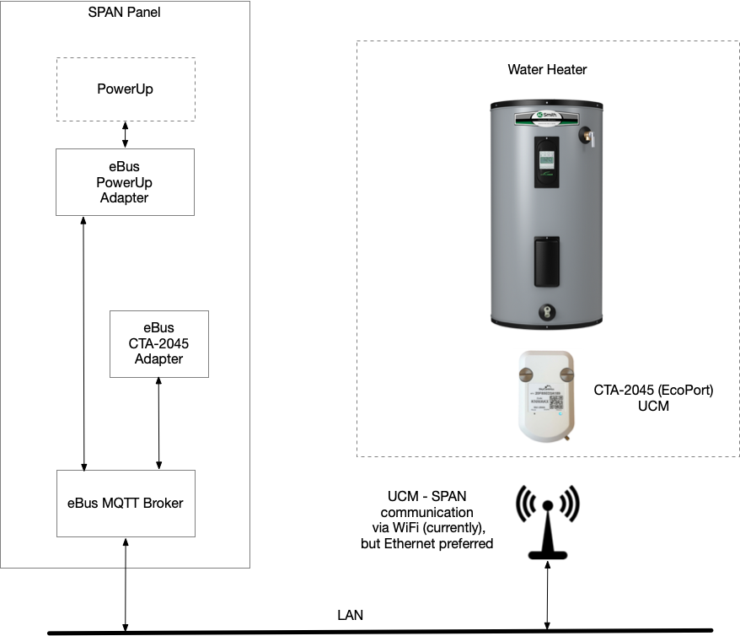
eBus CTA-2045 Adapter - Water Heater
An eBus Home Energy Management System (HEMS) controls power and shifts the energy consumption of a water-heater, using the water-heater’s integrated CTA-2045 (EcoPort) interface
A SkyCentrics UCM is used to connect (via Wi-Fi) to the eBus MQTT broker, the UCM transports/tunnels CTA-2045 messages and commands over MQTT
An eBus-CTA-2045 adapter converts/decodes the binary CTA-2045 messages/commands and re-publishes them to eBus topics in accordance with the eBus/Homie Convention
An eBus HEMS reads the status/mode of the WH, and can invoke shed and/or load-up commands via MQTT messaging

Slide 19
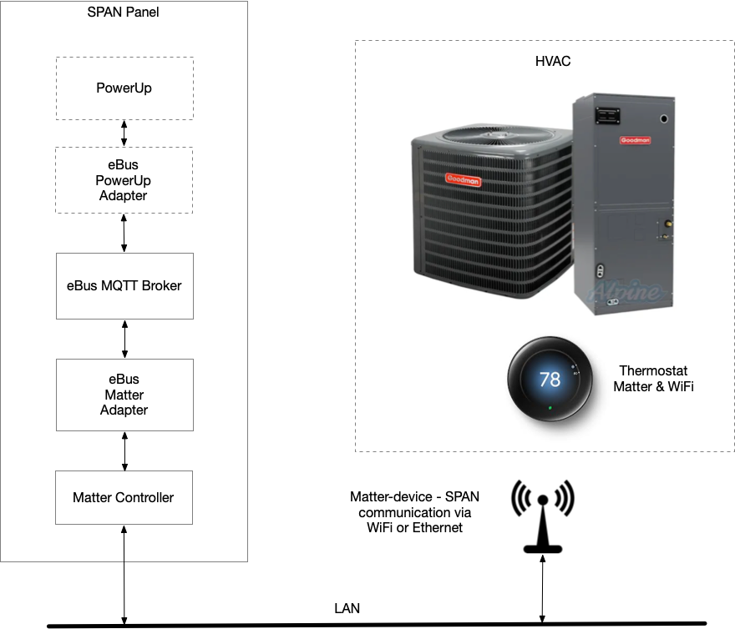
eBus Matter Adapter - HVAC/Thermostat
An eBus HEMS shifts energy consumption of a HVAC, by sending commands to a Matter-enabled Thermostat controlling the HVAC system
An eBus-Matter adapter bridges Matter device status to MQTT, in accordance with the eBus/Homie Convention
An eBus HEMS reads the HVAC system status via MQTT messages, and sends command message to adjust the HVAC setpoints, and set its mode (off, on, cooling, heating, auto, etc)

Slide 20
Calls to Action
HEI device manufacturers:
Adopt and support the eBus framework for your HEI devices
Hop aboard the eBus!!!
Developers:
Create eBus adapters to enable new/innovative integrations
Homeowners:
Demand eBus support for the HEI devices you buy

Slide 21
Futures - eBus Execution Contexts
eBus adapters run on a microcomputer/microcontroller somewhere (obviously), in other words, eBus adapters require an “execution context”
HEI device vendors can easily support eBus adapters within their products, but where will adapters by third-party developers run?
Today: Third-party adapters will need to bring their own execution context, for example, via a SBC/microcontroller connected to the home LAN
Tomorrow: Some eBus-supporting HEI devices may choose to provide installable “containers” (Docker-like, but likely lighter-weight, cgroups + namespacing), providing an execution context and access the the eBus MQTT broker

